Slide 1
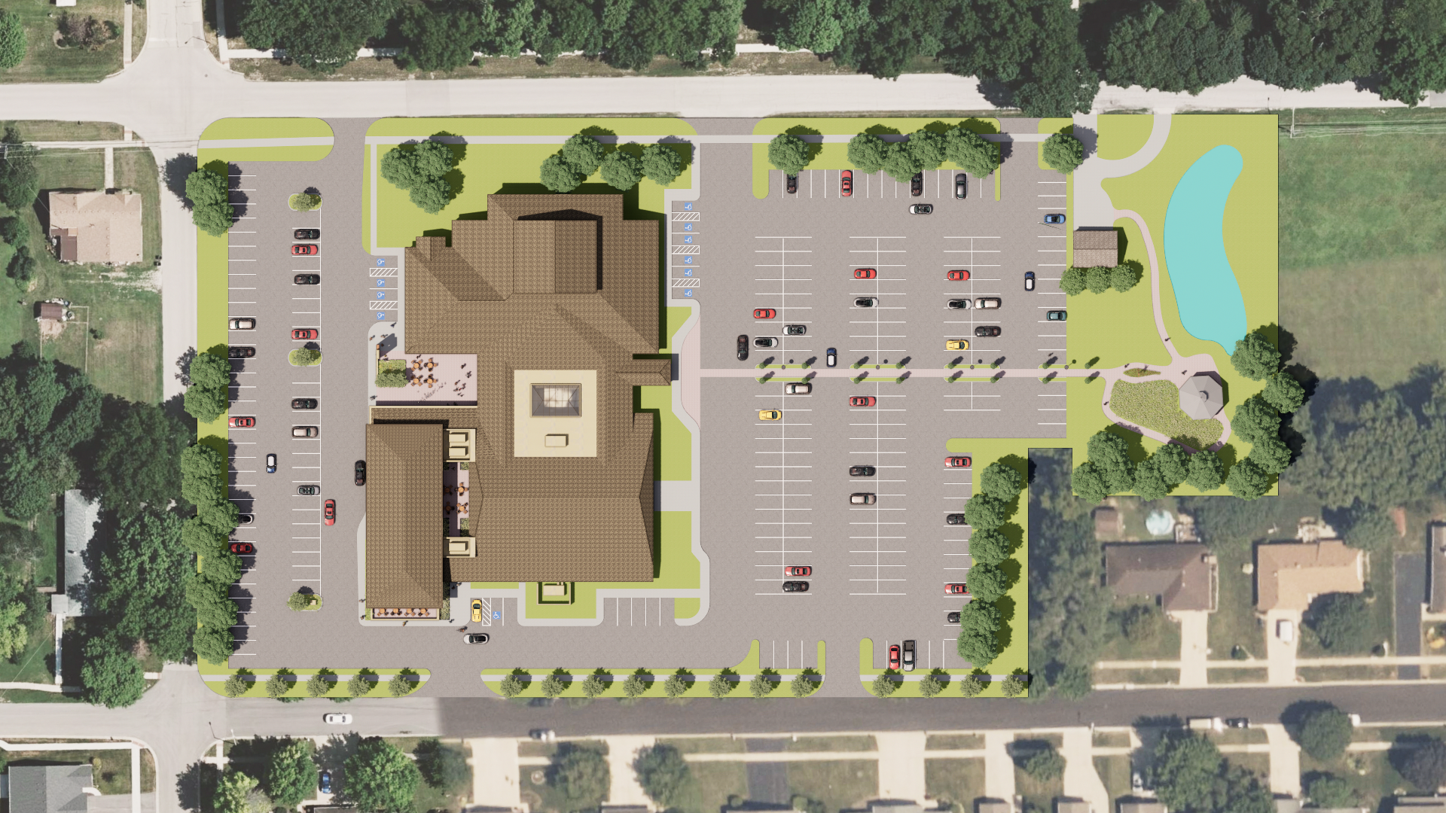


Site Plan

Slide 2
Site Plan - Phasing Diagram
Phase 1
Additional Parking
Phase 3A
Outdoor Gathering Area Cloister
Phase 1
Shell & First Level of Parish Center Addition
Phase 1A
Courtyard Infill / Narthex Expansion / Interior Renovation
Phase 2
Second Floor Level of Parish Center Addition
Phase 3
Lower Level of Parish Center Addition

Slide 3
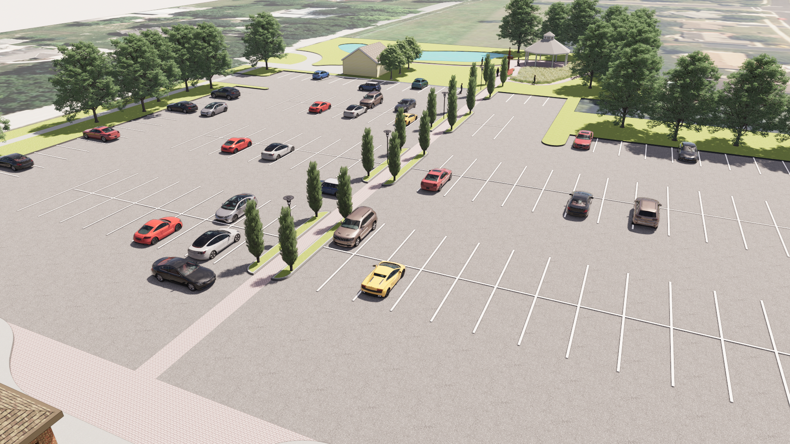
Aerial View Looking East Towards Shrine of St. Gianna

Slide 4
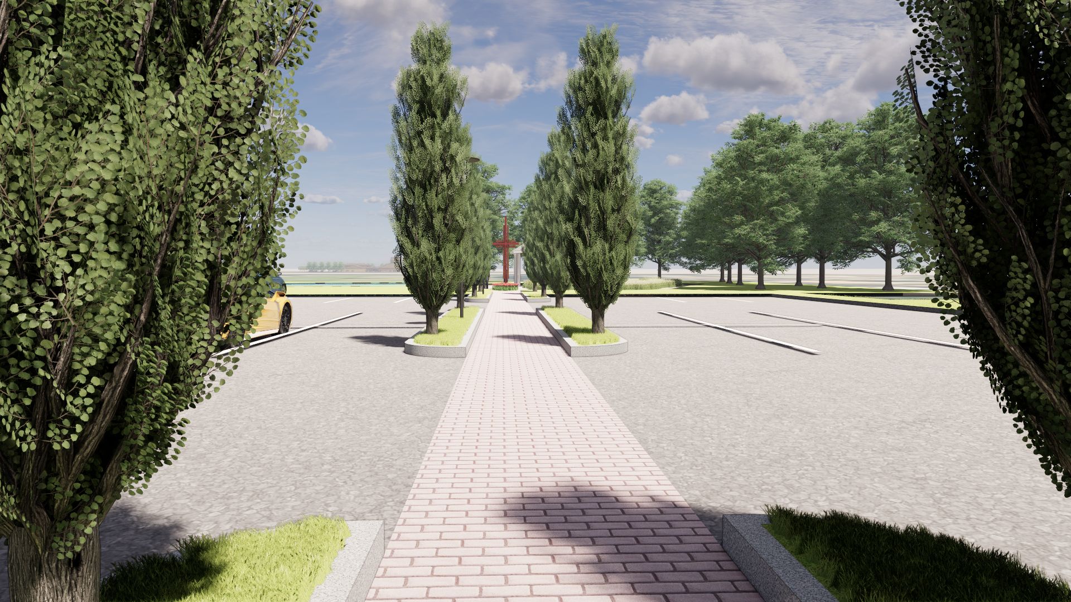
Ground View Looking East Towards Shrine of St. Gianna

Slide 5
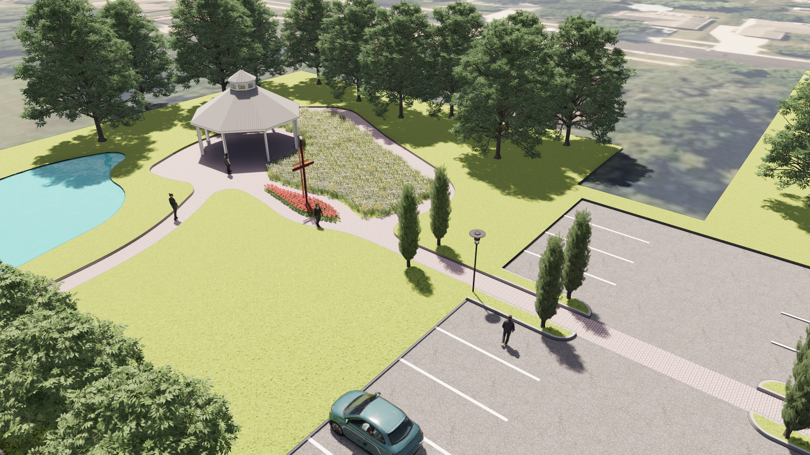
Aerial View of Shrine of St. Gianna Looking Southeast

Slide 6
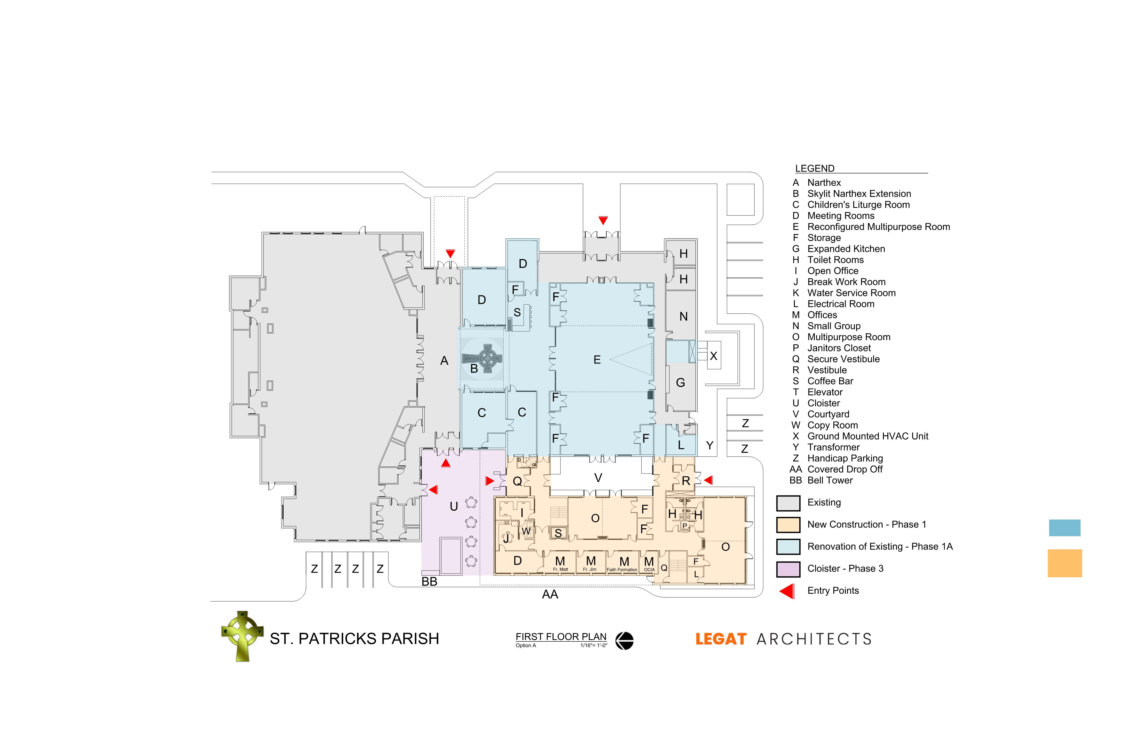
Parish Center Addition - First Level Floor Plan
Bell Tower - Phase 3A

Slide 7
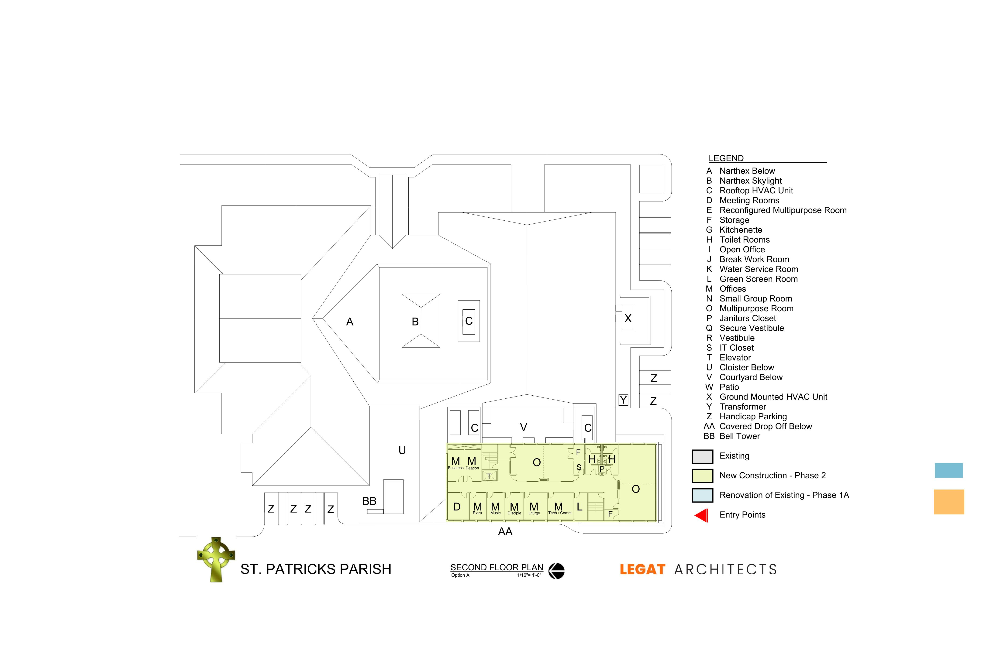
Parish Center Addition - Second Level Floor Plan

Slide 8
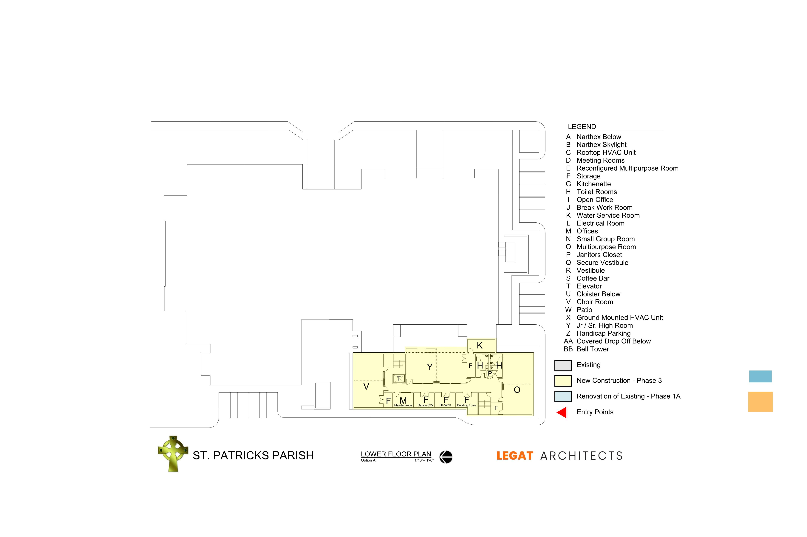
Parish Center Addition - Lower-Level Floor Plan

Slide 9
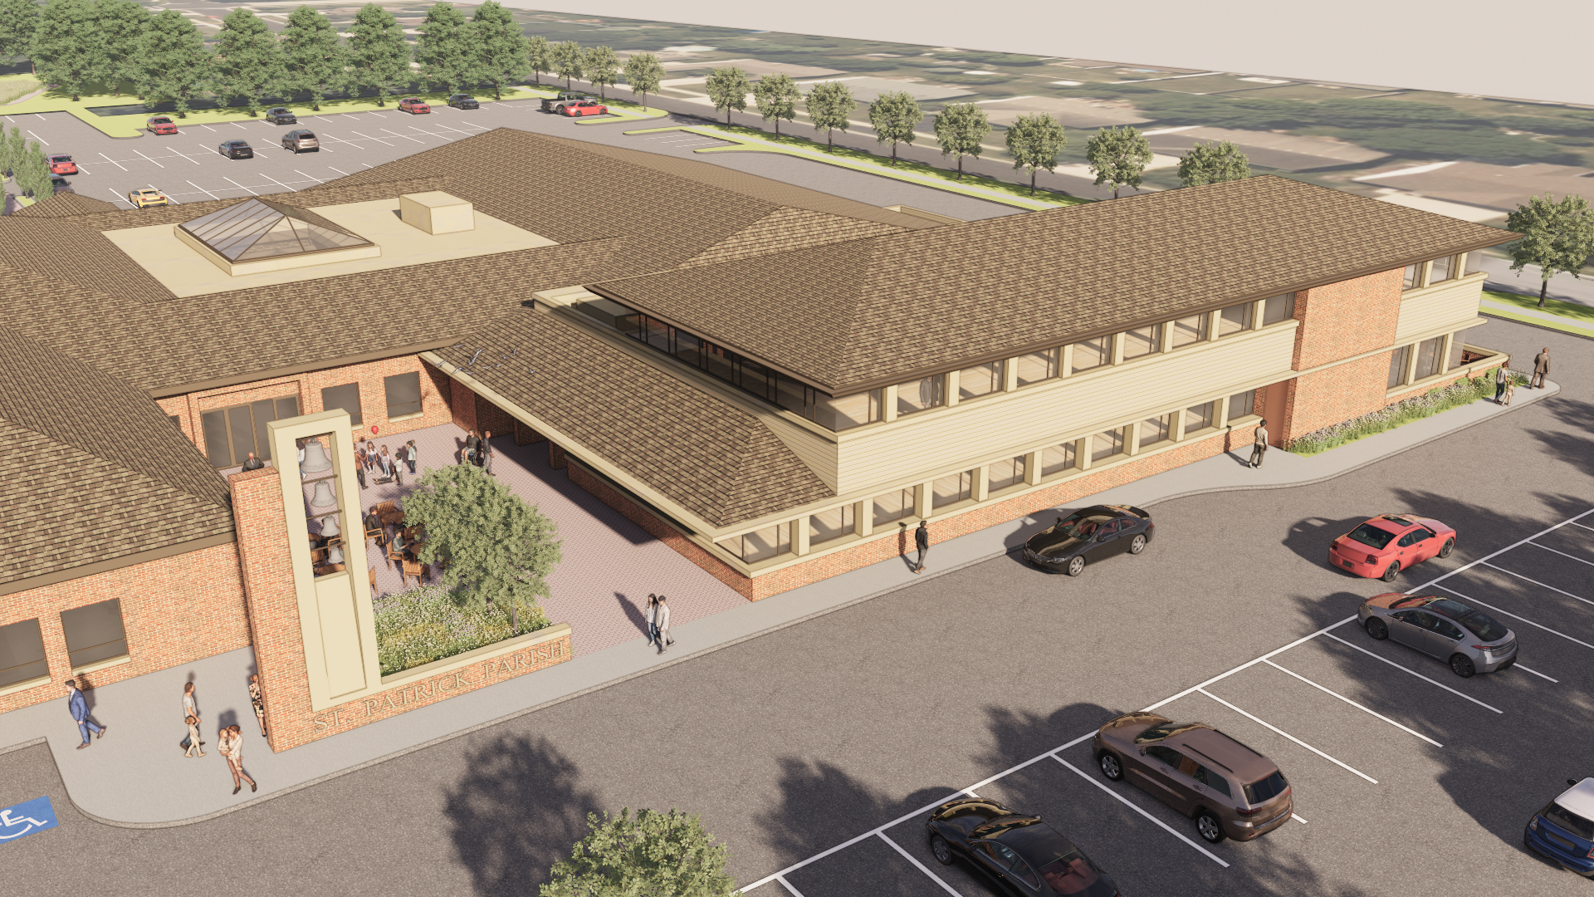
Overall Aerial of Parish Center Addition Looking Southeast

Slide 10
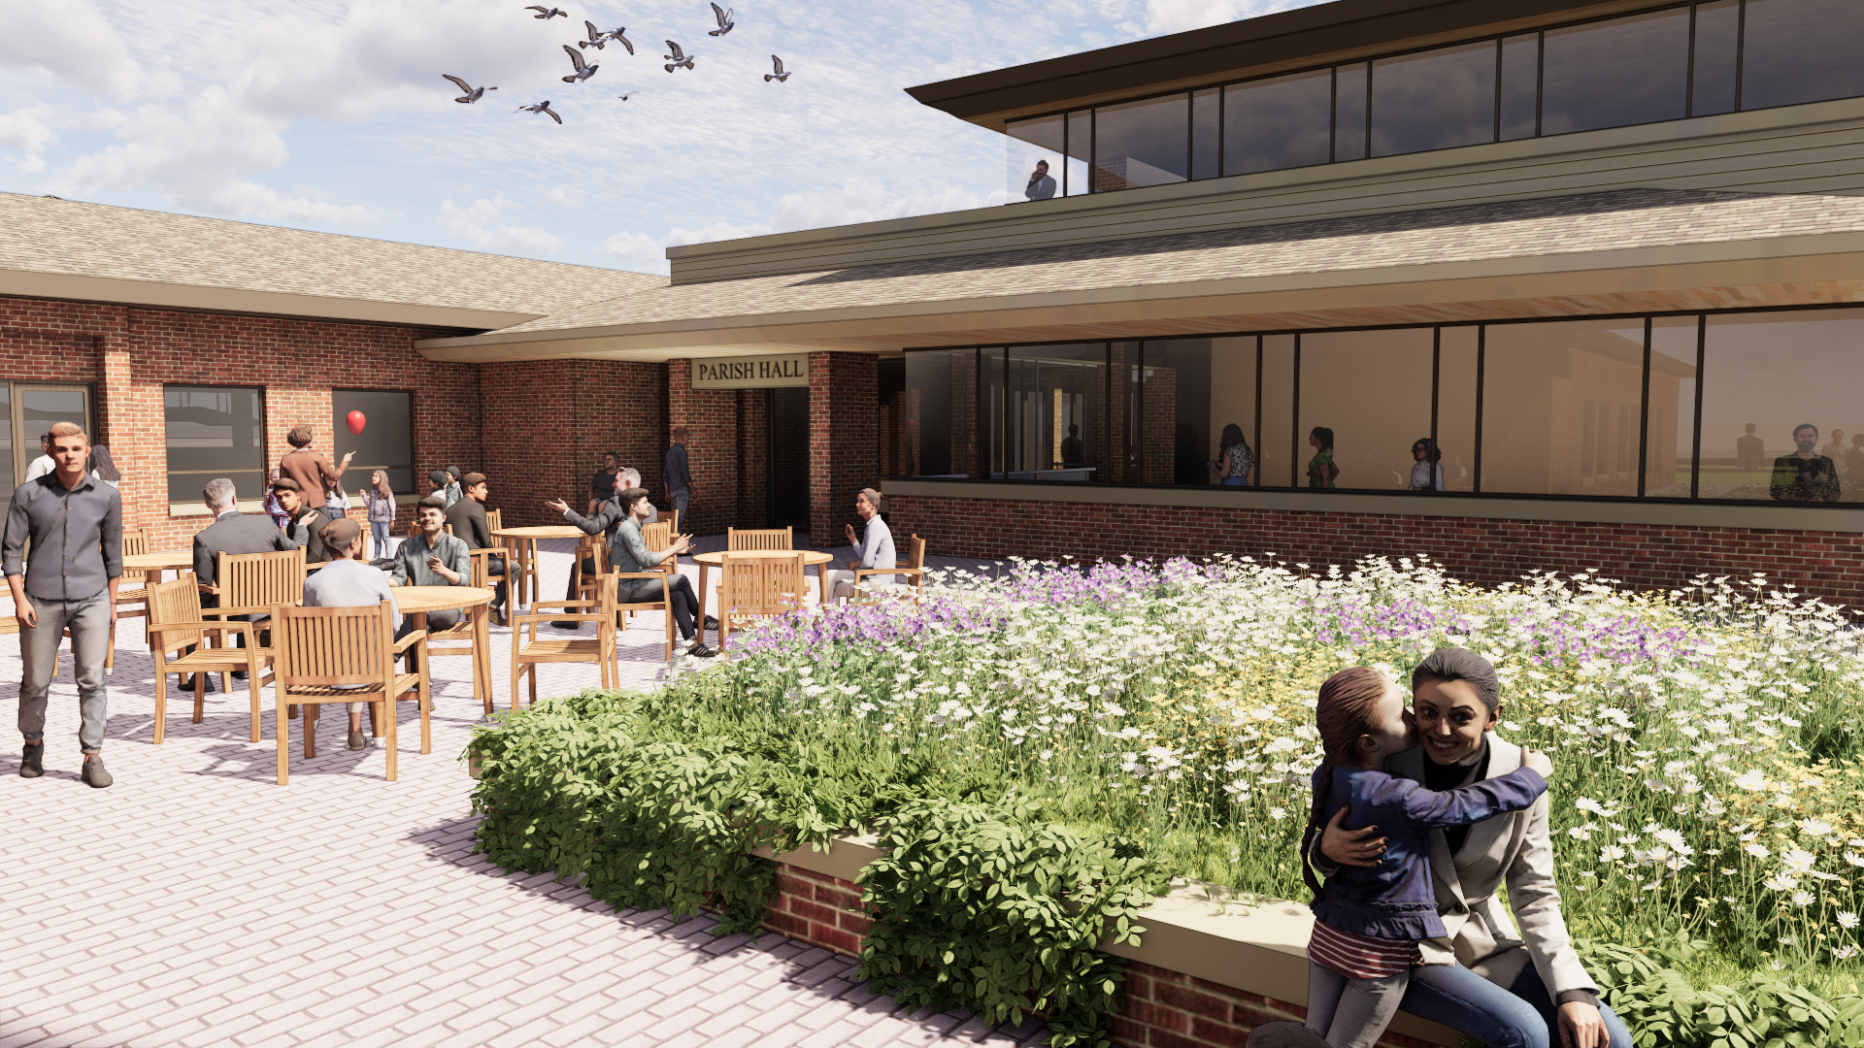
Ground View of Outdoor Gathering Area

Slide 11
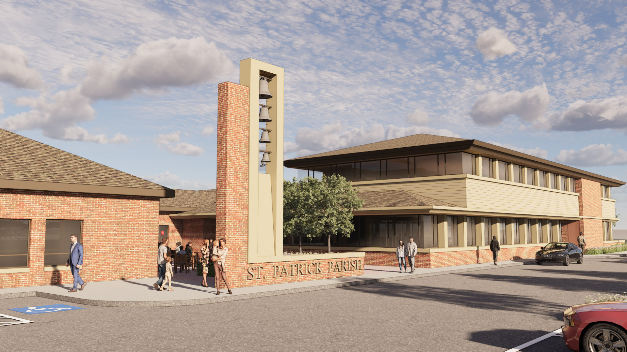
Ground View of Outdoor Gathering Area Looking Southeast

Slide 12
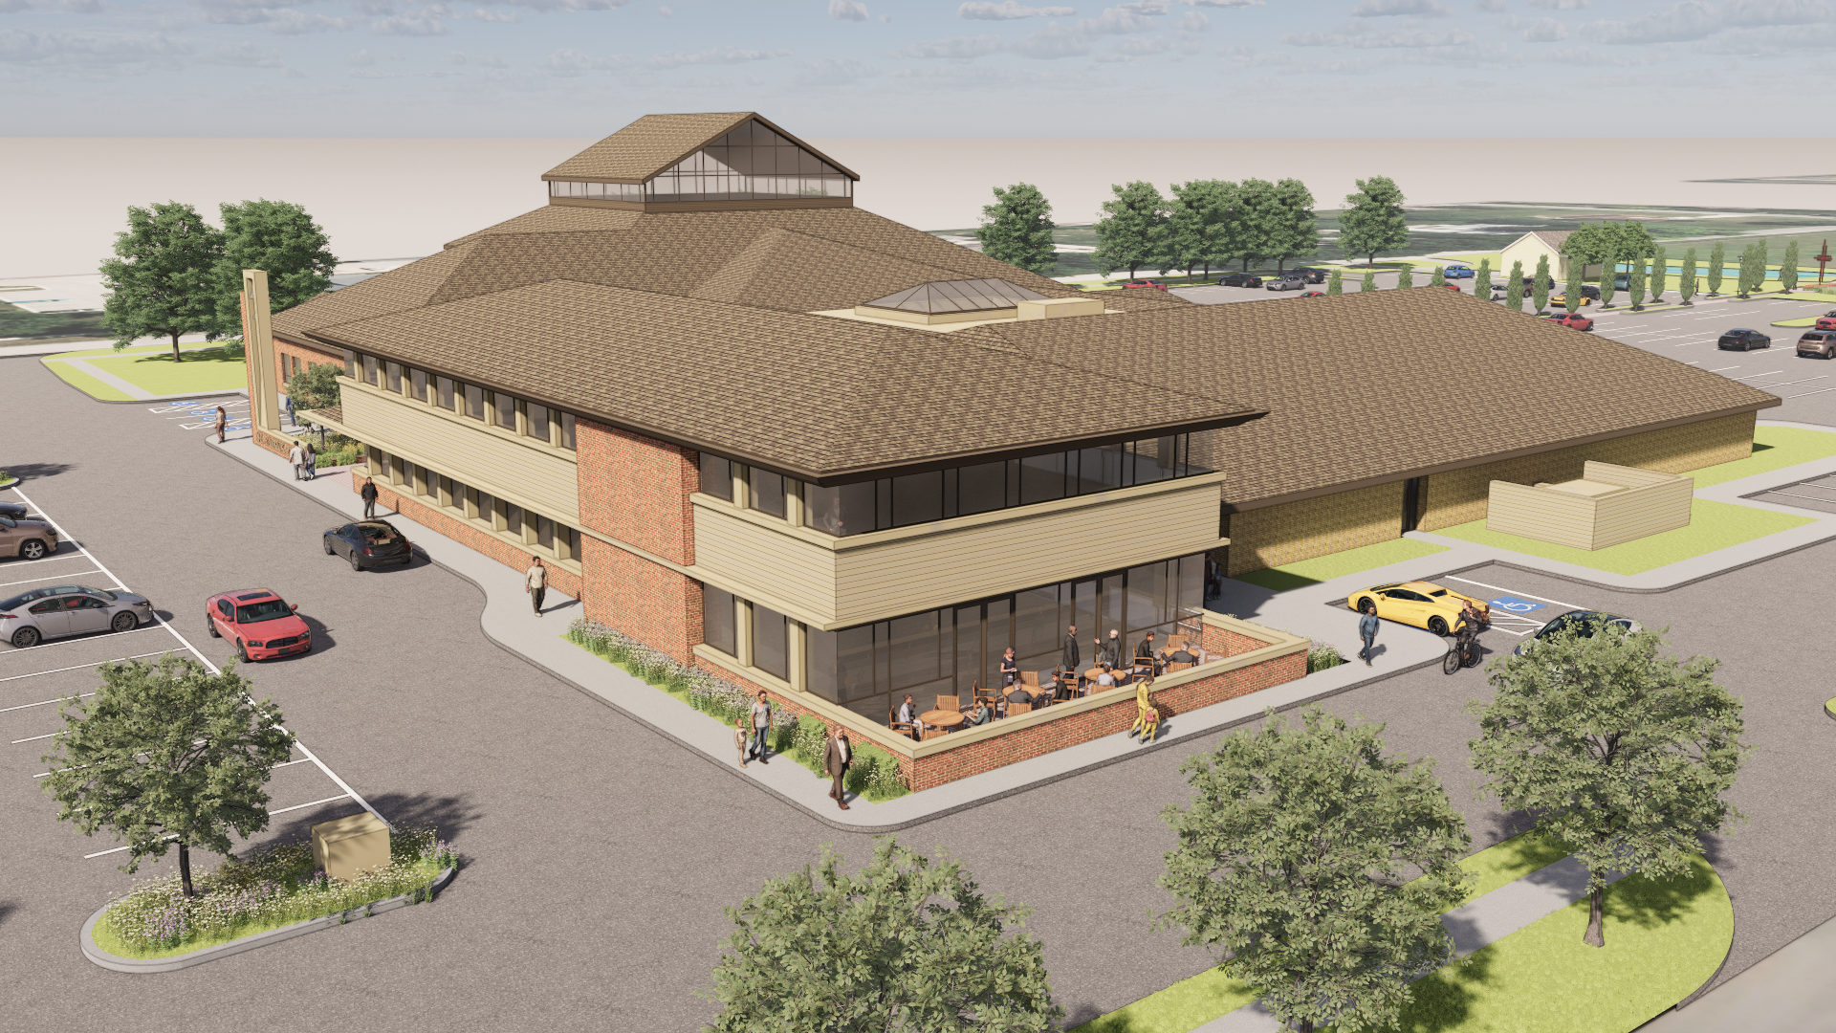
Aerial View of Parish Center Addition Looking Northeast

Slide 13
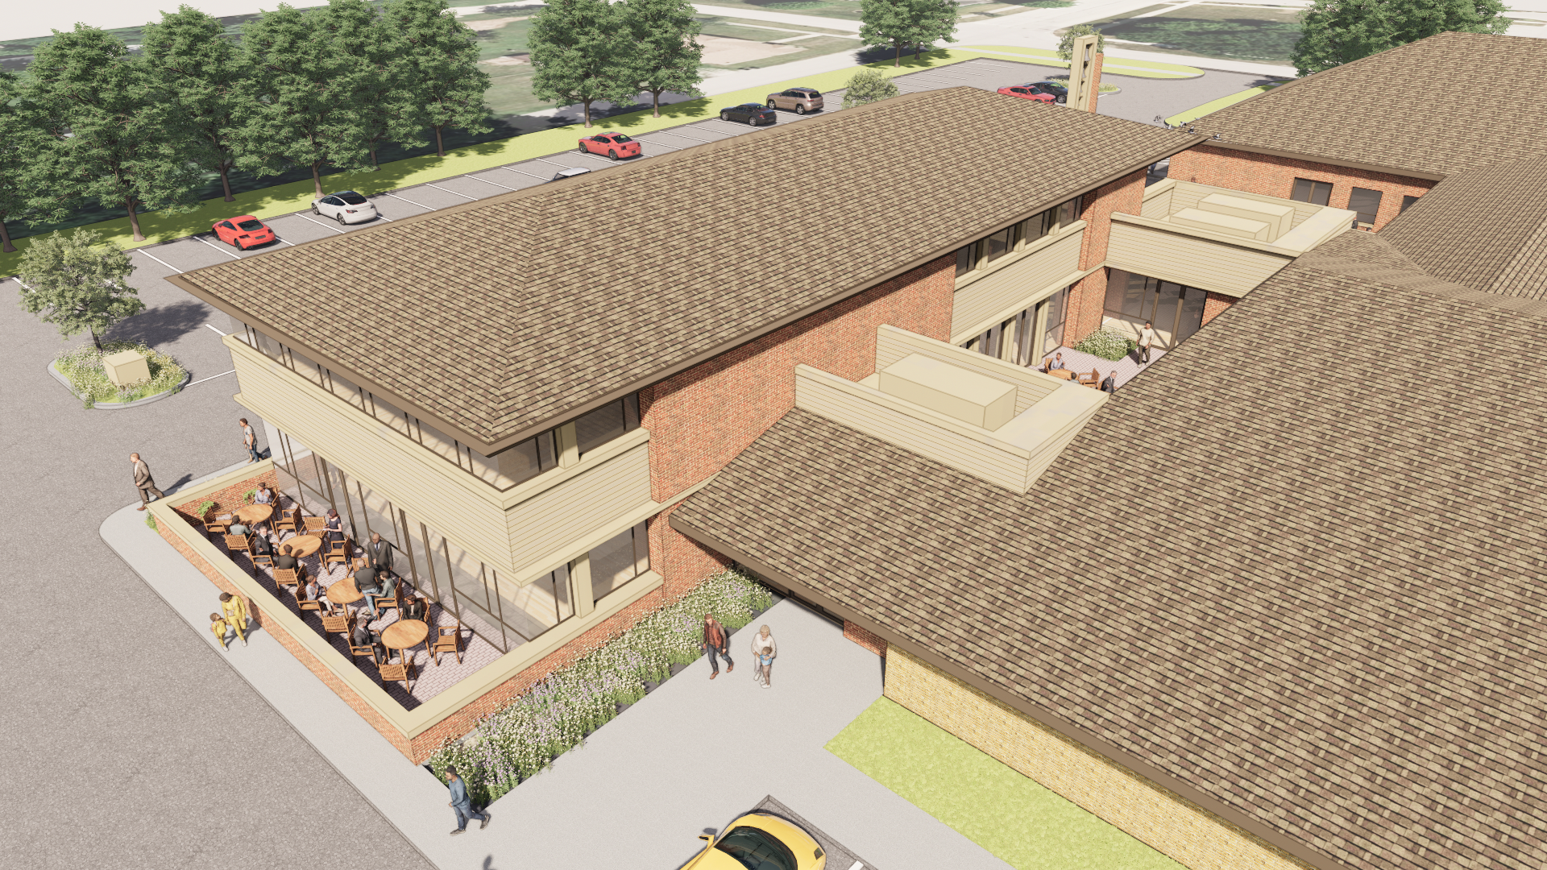
Aerial View of Parish Center Addition Looking Northwest

Slide 14
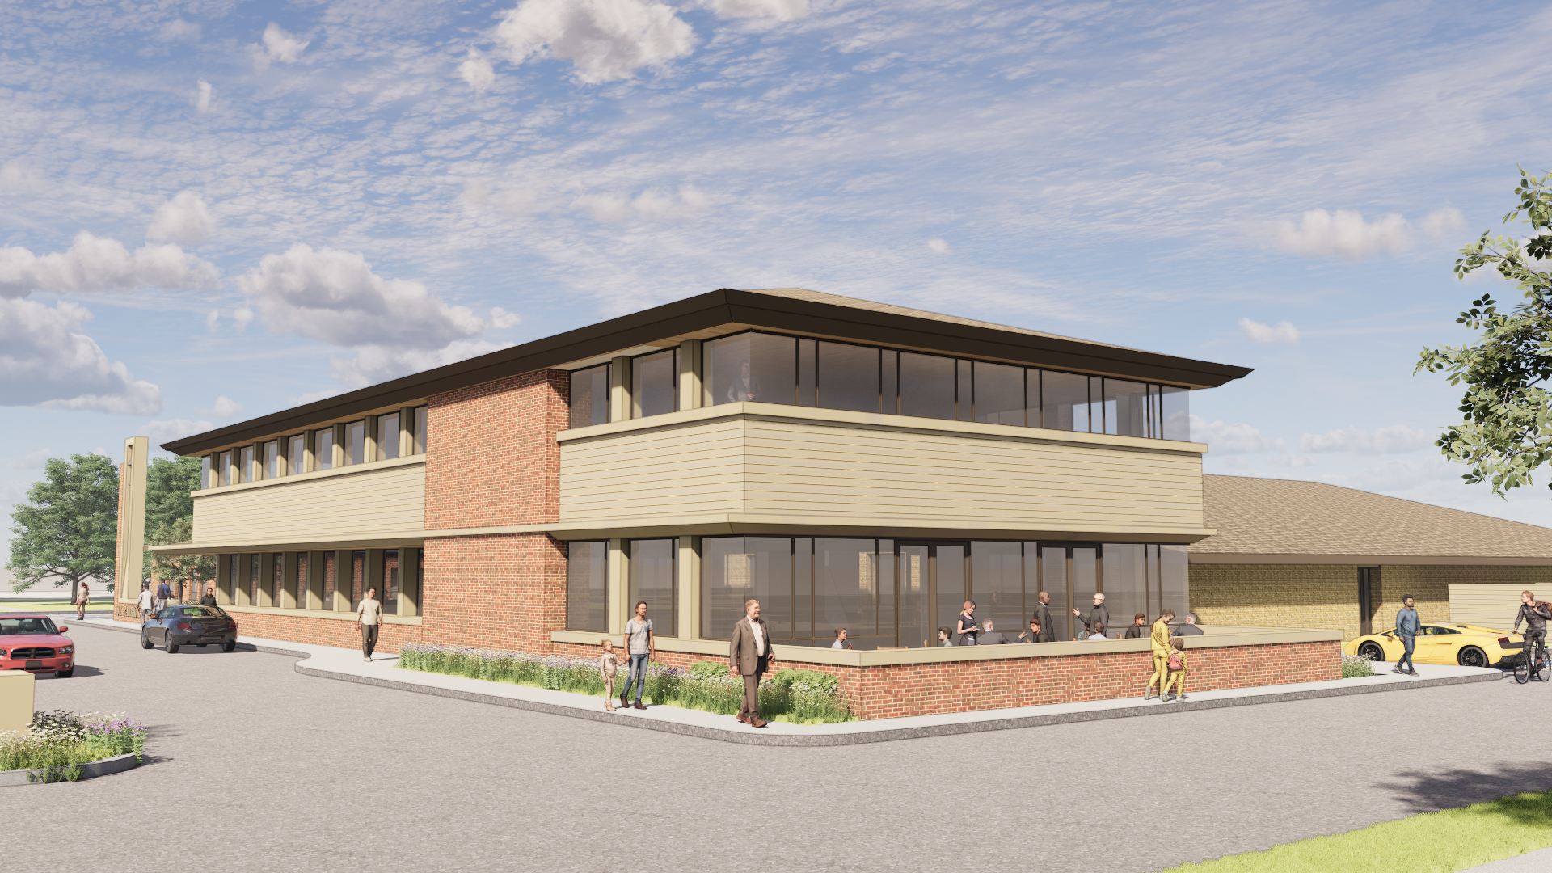
Ground View of Parish Center Addition Looking Northeast

Slide 15
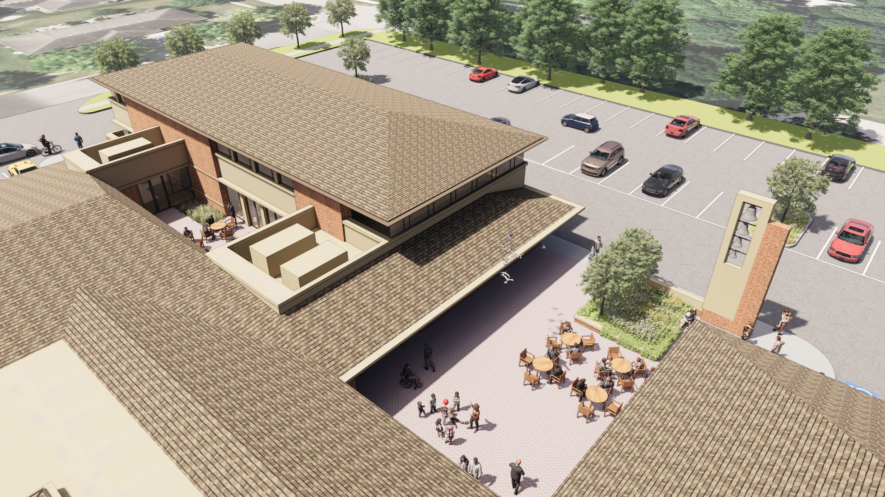
Aerial View of Parish Center Addition Looking Southwest

Slide 16
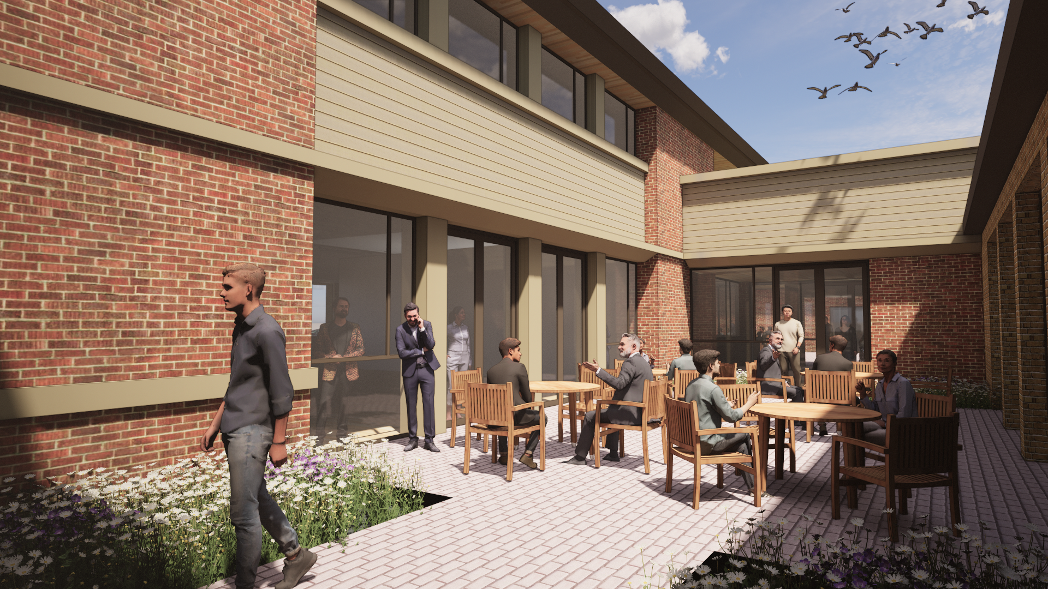
Ground View of Parish Center Addition Courtyard

Slide 17
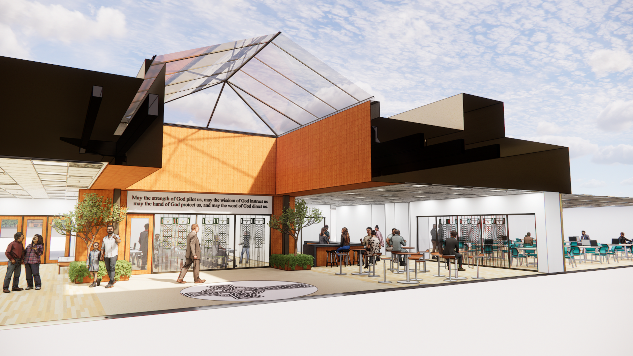
Section View of Courtyard Infill & Narthex Expansion

Slide 18
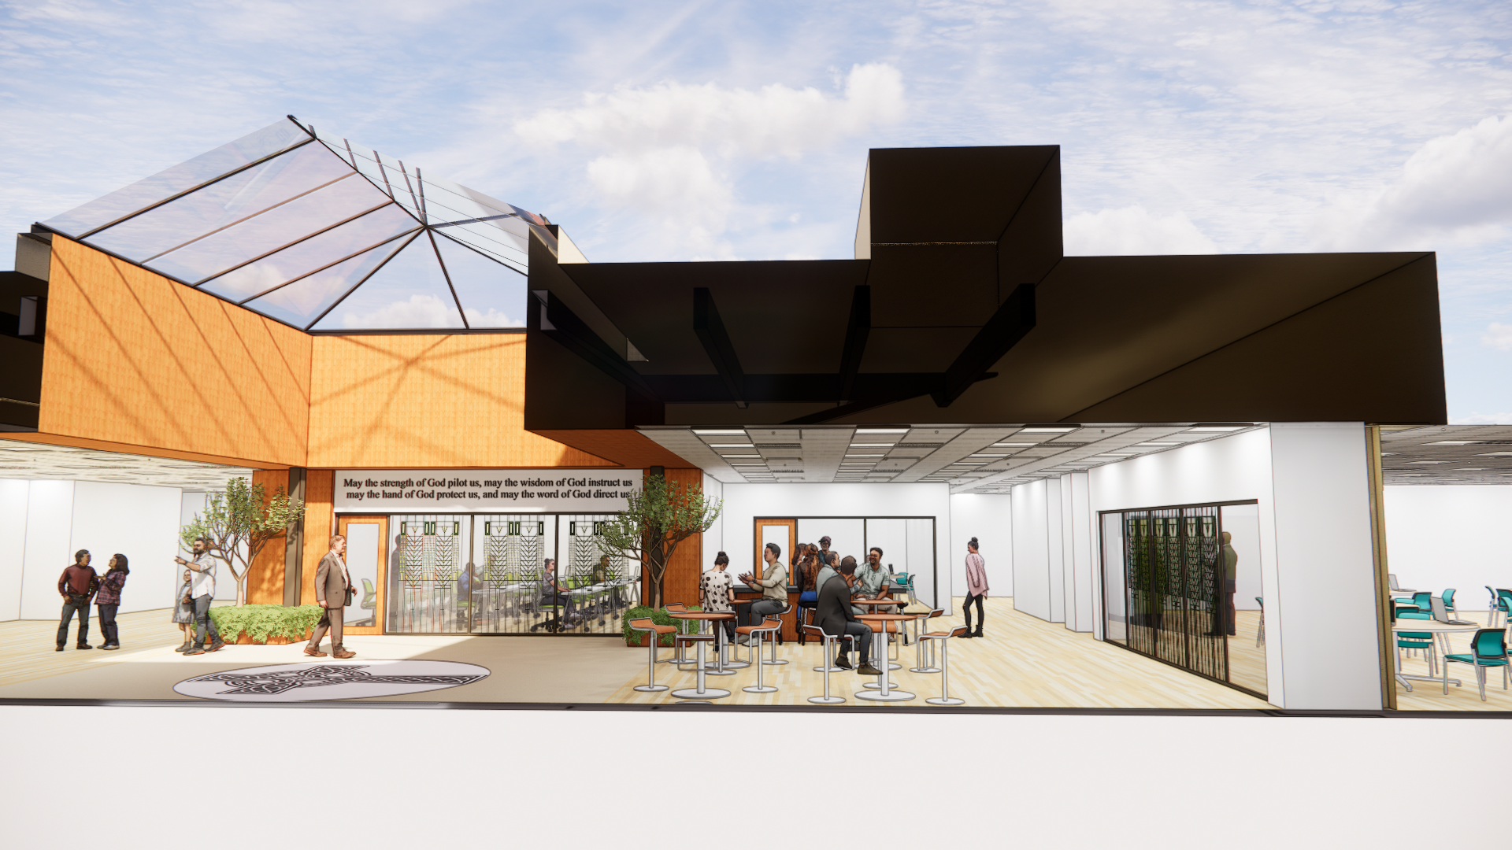
Section View of Courtyard Infill & Narthex Expansion

Slide 19
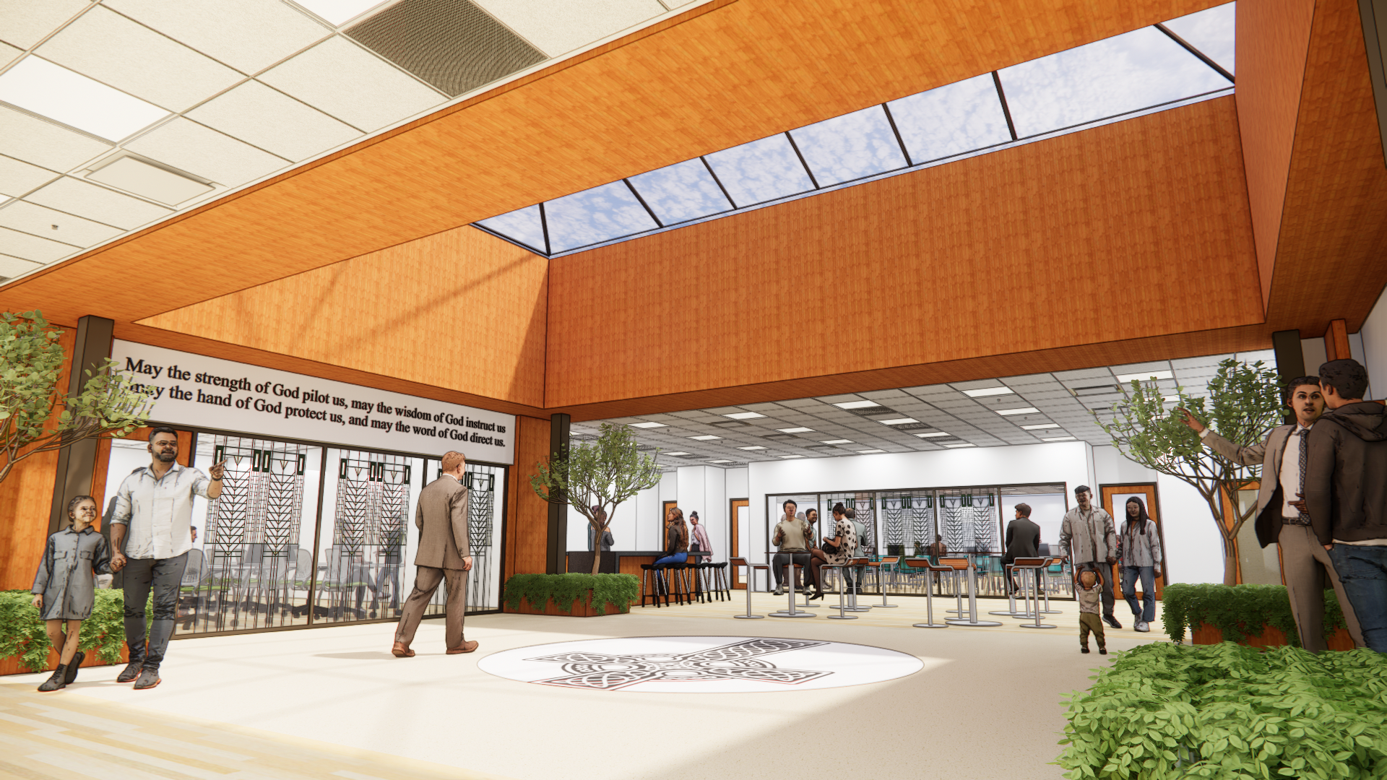
Interior View of Courtyard Infill & Narthex Expansion

